Slide 1
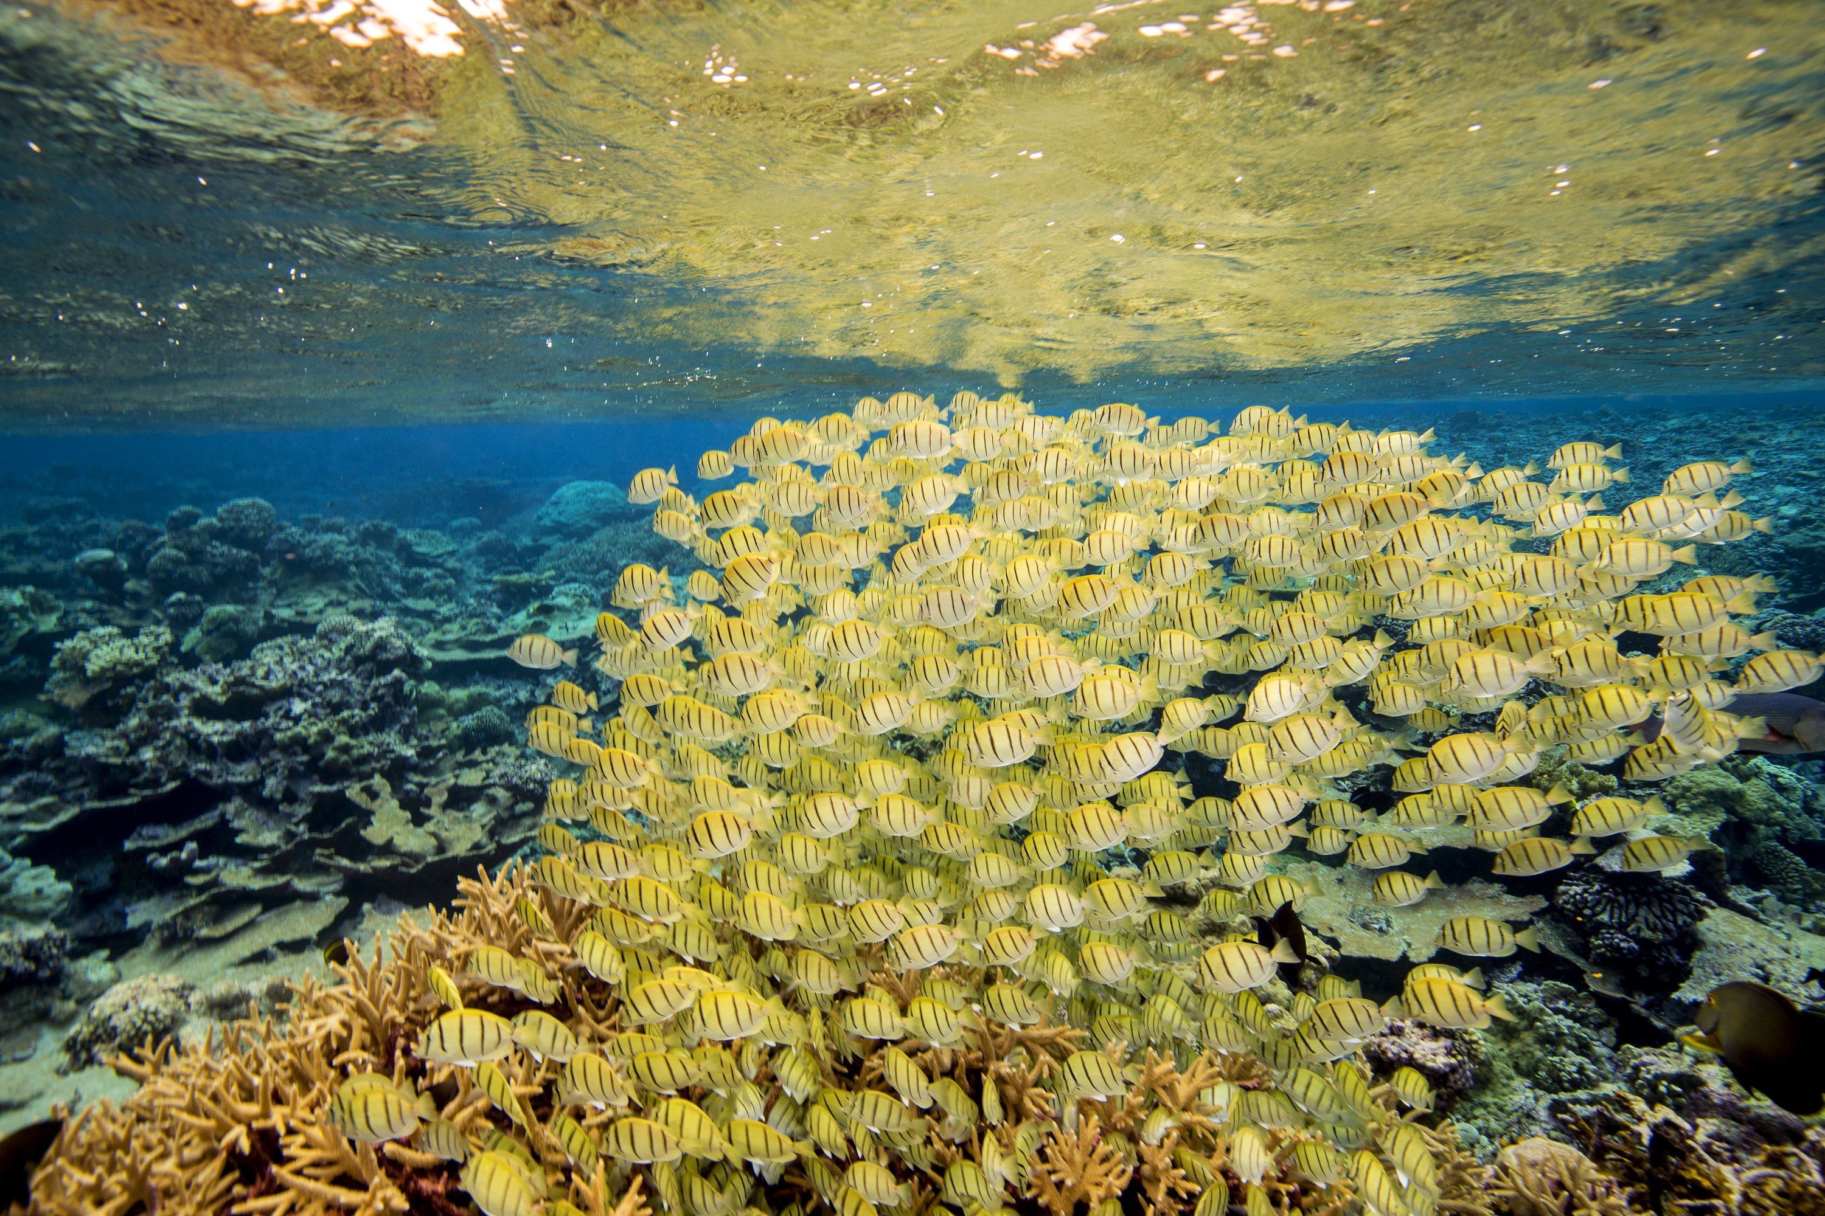
Pacific Island Coral Reef Fisheries
Designing Marine Managed Areas to Enhance and Maintain Coral Reef Fisheries
in the Pacific Islands
Notes:
1
Image credit: Ian Shive, manini
Key Messages –
-Establishing MMAs – especially permanently protected areas that provide good habitat for focal and important species - is one of the best ways that communities can maintain the long-term abundance and health of coastal and marine resources.
-Well designed and managed MMAs help to maintain or enhance populations of important fishery species, and biodiversity more broadly, to support community food security, livelihoods, and cultural practices.
-This presentation on design of MMAs is aimed at community leaders, conservation practitioners, and resource managers. We provide an overview of the role of marine managed areas in fisheries management and biodiversity conservation and science-based guidelines for design of MMAs in tropical marine environments of the Pacific.
___________________________________________________________________________________________________________
Scientific rationale and references:
Marine Managed Areas (MMAs), particularly no-take zones (NTZs), can be powerful tools to address local threats and enhance fisheries productivity, protect biodiversity, and increase resilience to changes in climate and ocean chemistry (Green et al. 2014, Roberts et al. 2017). They can also enhance food security and sustainable livelihoods for communities and other stakeholders.
Presentation overall draws heavily from:
Gombos, M., Atkinson, S., Green, A., & Flower, K. (Eds.). (2013a). Designing Effective Locally Managed Areas in Tropical Marine Environments: A Booklet to Help Sustain Community Benefits through Management for Fisheries, Ecosystems, and Climate Change. Jakarta, Indonesia: USAID Coral Triangle Support Partnership.
Green, A.L., Fernandes, L., Almany, G., Abesamis, R., McLeod, E., Aliño, P., White, A.T., Salm, R., Tanzer, J., Pressey, R.L. 2014. Designing marine reserves for fisheries management, biodiversity conservation and climate change adaptation. Coastal Management 42:143–159.
Green, A.L., Maypa, A.P, Almany, G.R., Rhodes, K.L., Weeks, R., Abesamis, R.A., Gleason, M.G., Mumby, P.J. and White, A.T. 2015. Larval dispersal and movement patterns of coral reef fishes, and implications for marine reserve network design. Biological Reviews 90 (4): 1215-1247.
Green, A.L., Fajariyanto, Y., Lionata, H., Ramadyan, F., Tighe, S., White, A., Gunawan, T., Rudyanto, and Minarputi, N. 2020. A Guide, Framework and Example:
Designing Marine Protected Areas and Marine Protected Area Networks to Benefit People and Nature in Indonesia. Report prepared by The Nature Conservancy (TNC) for the USAID Sustainable Ecosystems Advanced Project, 90 pp.
FAO (2011). FISHERIES MANAGEMENT 4. Marine protected areas and Fisheries. FAO TECHNICAL GUIDELINES FOR RESPONSIBLE FISHERIES. Suppl 4.
Copied directly from FAO Technical Report.
FISHPATH [www.fishpath.org] – outputs on spatial management considerations, assumptions, and caveats.

Slide 2
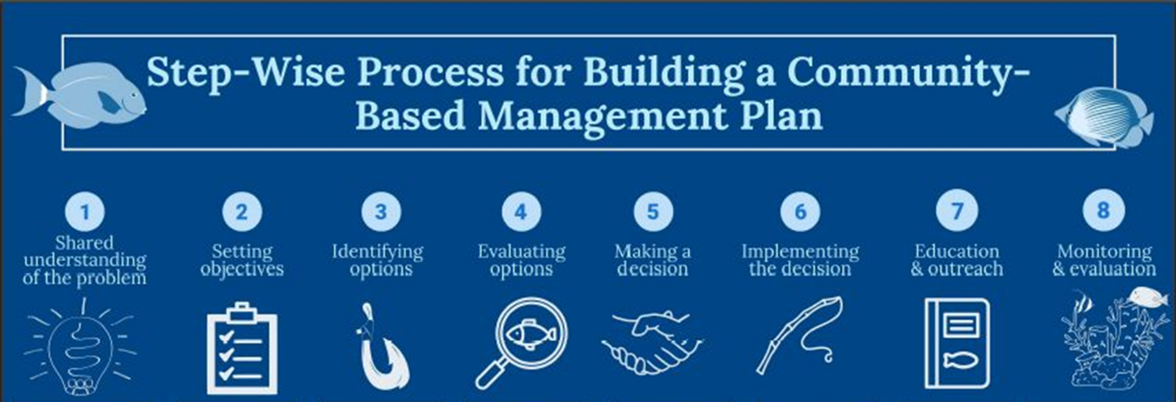
Pacific Island Coral Reef Fisheries
FISHPATH: Community- Based Fisheries Management Planning
Notes:
2
Image credit: Fishpath.org
Key Messages:
FishPath is a community-based process aims to address the key ecological, socioeconomic, and cultural concerns of stakeholders by developing a shared understanding of the problem and setting management objectives. Then the community can evaluate their options and select and implement management actions to achieve their objectives. This is followed by education and outreach on the management plan and monitoring and evaluation of its effectiveness.
It is in step 4, in particular, that the community should consider whether MMAs or, more specifically, FRZs are a good option to address their ecological and socioeconomic-cultural goals and management objectives.
The FishPath process aims to be inclusive and respectful of place, local communities, and local cultural and traditional ways…with a focus on addressing community concerns about the health of their fisheries and local ecosystems, their livelihoods and food supply, and continuation of traditional uses and practices.
The FishPath team is currently working on developing guidance materials and a facilitators guide for community-based fisheries management planning processes using the FishPath approach and toolkit
__________________________
Scientific Rationale
Fishpath url (www.fishpath.org)
-Dowling et al. Dowling, N.A., J.R. Wilson, M.B. Rudd, E.A. Babcock, M. Caillaux, J. Cope, D. Dougherty, R. Fujita, T. Gedamke, M. Gleason, N. Gutierrez, A. Hordyk, G.W. Maina, P.J. Mous, D. Ovando, A.M. Parma, J. Prince, C. Revenga, J. Rude, C. Szuwalski, S. Valencia, and S. Victor. 2016.
FishPath: A Decision Support System for Assessing and Managing Data- and Capacity-Limited Fisheries. In: T.J. Quinn II, J.L. Armstrong, M.R. Baker, J. Heifetz, and D. Witherell (eds.), Assessing and Managing Data-Limited Fish Stocks. Alaska Sea Grant, University of
Alaska Fairbanks. http://doi.org/10.4027/amdlfs.2016.03

Slide 3

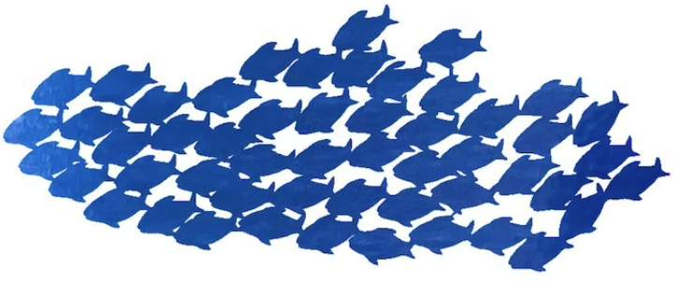
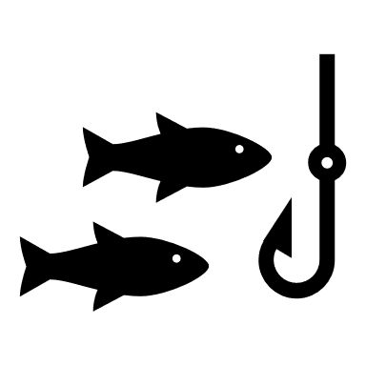
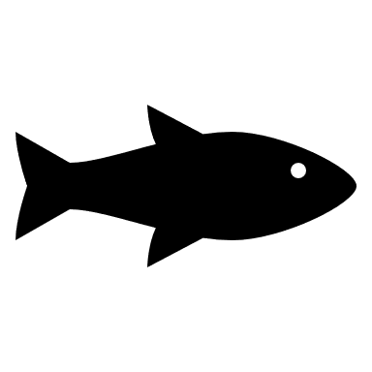




FISHKIT – Fisheries Toolkit
Helping Communities Explore Their Management Options
Gear Restrictions
Bag limits
MMAs or FRZs
or other zones
Spatial management
Size & Slot limits
Spawning Seasonal
and/or Time of day Closures
Notes:
Image credit: Rebecca Most (TNC), Fishpath. org
Key Messages -
Communities have a handful of management options they can use - things like bag or catch limits, spatial management, size and slot limits, temporary closures, and gear restrictions – to help rebuild their fisheries and protect their resources.
Different tools may be more appropriate in different biophysical and socioeconomic-cultural contexts. For example, the ecology of the fishery species may determine whether spatial management or other tools would be more effective (MMAs are less effective for very mobile species unless the MMAs are very large).
In a more traditional socioeconomic context, more traditional management tools may be more effective. For example, using local lunar spawning calendars to establish community-based spawning closures. In more urban context, other catch or gear restrictions may be easier to implement and enforce.
These management options can be used alone or in combination and the right management options depend on local conditions related to the health of the ecosystem and fisheries, the biology and population status of the species involved, and the social acceptance and enforceability of different approaches, among other factors.
_________________________________________________________________________________________________
Explanatory text and Scientific Rationale –
From FAO (2011). FISHERIES MANAGEMENT 4. Marine protected areas and Fisheries. FAO TECHNICAL GUIDELINES FOR RESPONSIBLE FISHERIES. Suppl 4.
Copied directly from FAO Technical Report - Section2.5 IN WHAT SITUATIONS ARE MPAs USEFUL AS A FISHERIES
MANAGEMENT TOOL?
MPAs should not be viewed as a solution for all fisheries management problems. They do not address key issues for the overall management of the
area beyond the boundary of an MPA. Nor do they redress past unsuccessful fisheries management that has, in many cases, led to overcapacity, overfishing
and economic loss. Moreover, if MPAs were to be used as the sole mechanism for limiting the amount of fish to be caught, with a view to sustaining fish
populations, the extent of the area to be protected might be unrealistically large, particularly for mobile fish species, even if successful in meeting ecological
objectives, the approach would waste a large portion of potential economic benefits. In many circumstances, MPAs will be inferior to an appropriate
mix of other fisheries management tools in terms of the combined protection offered, potential yield and economic performance, as long as these tools are
effectively implemented.
With the move towards an ecosystem approach in the management of the world’s oceans, however, MPAs can be a very useful component within
the fisheries management toolbox. In several situations, there is a need for a greater consideration of MPAs as a main management measure, although
the best results may still be achieved with a combination of fisheries and ecosystem management tools. Multiple tools are available for achieving
fisheries objectives and these should be selected and balanced within the relevant policy and management frameworks”.
Some cases where MMAs may be most valuable for fisheries:
-Controlling fish mortality of sedentary species in data-poor situations
-Assisting management of multispecies fisheries
-Minimizing bycatch and protecting habitat and biodiversity
-Buffering against uncertainty
-Protecting traditional and cultural use rights and practices
-Protecting and enhancing local livelihoods
-Resolving user conflicts

Slide 4
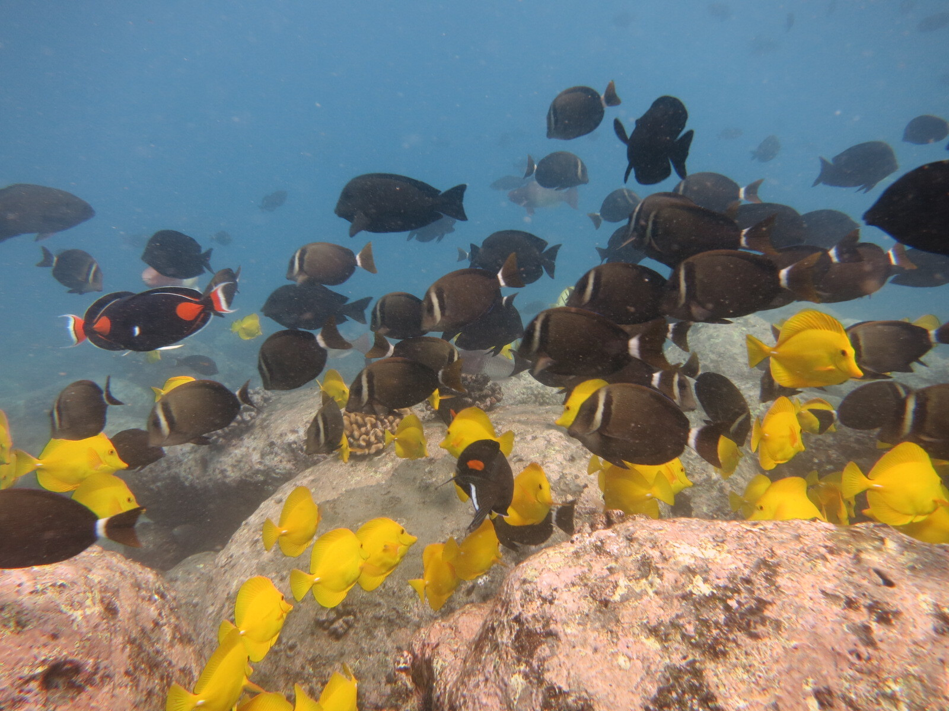
Design of Marine Managed Areas
What is needed to keep resources healthy and abundant?
Healthy Habitats: where species can live, eat, grow, and reproduce.
Large Enough Area: to support species throughout their life cycles.
Successful Reproduction: enough individuals of reproductive size to maintain populations.
Effective Community-based Management: community support and benefits.
Notes:
4
Image credit: Chad Wiggins (TNC)
Key Messages:
There are basic needs that are required for marine resources to remain healthy, abundant, and therefore resilient, so they can continue to provide benefits to the community:
a. Healthy Habitat – Habitats are areas that are used by marine species to eat, live, grow, and reproduce. If a habitat used for any one of these functions is damaged, it could have negative impacts on the populations on all species that use that habitat during their life cycles.
b. Large Enough Areas of Habitat – Different species have different movement patterns as adults and as larvae. In order to grow into large adults that successfully reproduce in the long term, marine species need a large enough area of habitat to move according to their natural patterns.
c. Successful Reproduction – If a species cannot successfully grow into adults and reproduce, the population will decline over time. If babies or juveniles are removed before they become reproductive adults, there will not be any reproduction to maintain population numbers. You need enough Individuals of reproductive size to maintain populations. This requires that MMAs are in the right place, large enough and in place long enough to support species throughout their lives.
d. Effective Management That Provides Community Benefits and has community support –The community must agree to effectively manage their resources. This includes establishing zones and rules that encourage successful reproduction, maintaining large enough areas of healthy habitats,
and providing sustainable community benefits. For community members to remain supportive of management, they need to benefit from the management and from the sustainable utilization of their marine resources.
___________________________________________________________________________________
Scientific Rationale and References:
Gombos et al. 2013a.
Green et al 2014.
Green et al. 2020.

Slide 5
Design of Marine Managed Areas
When to consider spatial management?
When management objectives can best be achieved by regulating activities in an area.
When populations of focal fishery species have declined and protecting fish and fish habitat will support rebuilding and recovery.
When managing multiple species, particularly those that do not move too far.
As one option in the fisheries management toolkit (alongside catch limits, size limits, etc.)
Notes:
5
Key Messages -
-MMAs can help to protect those basic needs and achieve both fishery and biodiversity objectives. When should spatial management be considered as an option?
-If management objectives depend on regulating activities in a given area – and if they are appropriately designed to achieve those outcomes.
-In areas where there is or has been overfishing and populations of focal fisheries species have declined, then fully protected areas can play an important role in enhancing fisheries yields and protecting biodiversity. This will only be the case if the area has the required habitats and a large enough size to support the maintenance or recovery of focal species. Its important to remember you have to work with the ecology of the focal species.
When managing multiple species
-where single-species regulations like catch limits or size limits would be ineffective
-species that remain in an area throughout their lives and don’t move too far. Also for species whose populations depend upon a specific area like a spawning site.
-MMAs are an important tool in the fisheries management toolkit and can be used alongside bag/catch limits, size limits, seasonal spawning area closures, etc..
___________________________________________________________________________________________________________________________
Scientific Rationale and References:
From Green et al. (2017) Biophysical Principles for Designing a Network of Replenishment Zones for the Mesoamerican Reef System. Technical report produced by The Nature Conservancy, Comunidad y Biodiversidad, A.C., Smithsonian Institution, Perry Institute for Marine Science, Centro de Estudios Marinos, Healthy Reefs Initiative and Universidad Autónoma de Baja California Sur, 64 pp. “The degree to which FRZs can contribute to enhancing fisheries yield depends on how well the fishery is managed beyond their boundaries (reviewed in Botsford et al. 2014). Where a fishery is well managed (e.g. at or below Maximum Sustainable Yield), adding FRZs may diminish yield because the fishable area is decreased. Conversely, in areas like the MAR where there is overfishing and populations of focal fisheries species have declined (Kramer et al. 2015), FRZs can play an important role in enhancing fisheries yields (Botsford et al. 2014). However, RZs can only be effective fisheries management tools if they are well designed and effectively managed (Green et al. 2014a)”.
From FAO (2011). FISHERIES MANAGEMENT 4. Marine protected areas and Fisheries. FAO TECHNICAL GUIDELINES FOR RESPONSIBLE FISHERIES. Suppl 4.
Copied directly from FAO Technical Report - Section2.5 IN WHAT SITUATIONS ARE MPAs USEFUL AS A FISHERIES
MANAGEMENT TOOL?
MPAs should not be viewed as a solution for all fisheries management problems. They do not address key issues for the overall management of the
area beyond the boundary of an MPA. Nor do they redress past unsuccessful fisheries management that has, in many cases, led to overcapacity, overfishing
and economic loss. Moreover, if MPAs were to be used as the sole mechanism for limiting the amount of fish to be caught, with a view to sustaining fish
populations, the extent of the area to be protected might be unrealistically large, particularly for mobile fish species, even if successful in meeting ecological
objectives, the approach would waste a large portion of potential economic benefits. In many circumstances, MPAs will be inferior to an appropriate
mix of other fisheries management tools in terms of the combined protection offered, potential yield and economic performance, as long as these tools are
effectively implemented.
With the move towards an ecosystem approach in the management of the world’s oceans, however, MPAs can be a very useful component within
the fisheries management toolbox. In several situations, there is a need for a greater consideration of MPAs as a main management measure, although
the best results may still be achieved with a combination of fisheries and ecosystem management tools. Multiple tools are available for achieving
fisheries objectives and these should be selected and balanced within the relevant policy and management frameworks”.
Some cases where MMAs may be most valuable for fisheries:
Controlling fish mortality of sedentary species in data-poor situations
Assisting management of multispecies fisheries
Minimizing bycatch and protecting habitat and biodiversity
Buffering against uncertainty
Protecting traditional and cultural use rights and practices
Protecting and enhancing local livelihoods
Resolving user conflicts
FISHPATH (2022) – output for spatial management considerations and caveats.
Spatial management can be especially important where there are spatial distinctions in the fishery that warrant spatially heterogeneous management. Examples of such spatial distinctions may include: Fisheries with sedentary or sessile species that form local or metapopulations (such as abalone); fisheries where the relative abundance or availability of the stock is spatially disaggregated; fisheries with concentrated areas of fishing effort (e.g., concentrated fishing effort in response to spatial “hot spots” or due to an area’s proximity to a port or urban center); or fisheries with identified ‘vulnerable’ areas, including areas with spawning or nursery grounds, areas where habitat needs to be allowed to regenerate, and areas with threatened, endangered, or protected species or habitat. [From FishPath outputs].

Slide 6
Design of Marine Managed Areas
What are Marine Managed Areas (MMAs)?
Clearly delineated areas of ocean, reef and shoreline that contribute to maintaining or enhancing natural resources by managing the types of uses allowed within their boundaries.
Notes:
6
Image – from Gombos et al. 2013a.
Key Messages –
Marine managed areas can take different forms with different expected outcomes for natural resources.
Marine Managed Areas (MMAs) are clearly delineated areas of ocean, reef and shoreline that contribute to maintaining or enhancing natural resources by managing the types of uses allowed within their boundaries. They include, but are not limited to, areas with fisheries management rules and zones such as gear restrictions or size or catch limits, bans on destructive fishing practices, zones for limiting take during spawning, No-Take Fisheries Replenishment Zones (FRZs or no-take zones), and so on.
- There are a variety of other types of managed areas and their naming conventions differ by region. A couple of examples include:
-Fisheries Replenishment Zones (FRZs) are a type of MMA and are areas of ocean that are protected from extractive and destructive activities and areas with restrictions regarding access and activities (e.g., for fisheries or tourism). They are sometimes called No-Take Zones.
-Seasonal closures – can be important for protecting focal species during critical life stages (e.g. in spawning or nursery areas during reproductive seasons), which can be very important to protect or restore populations of these species.
-Locally managed areas may also cultural or traditional management such as sasi (West Papua), tambu or tabu (no take areas) in some Pacific islands.
____________________________________________________________________________
Scientific Rationale and References:
Gombos et al. 2013a – for definitions.
Green et al. 2020.

Slide 7
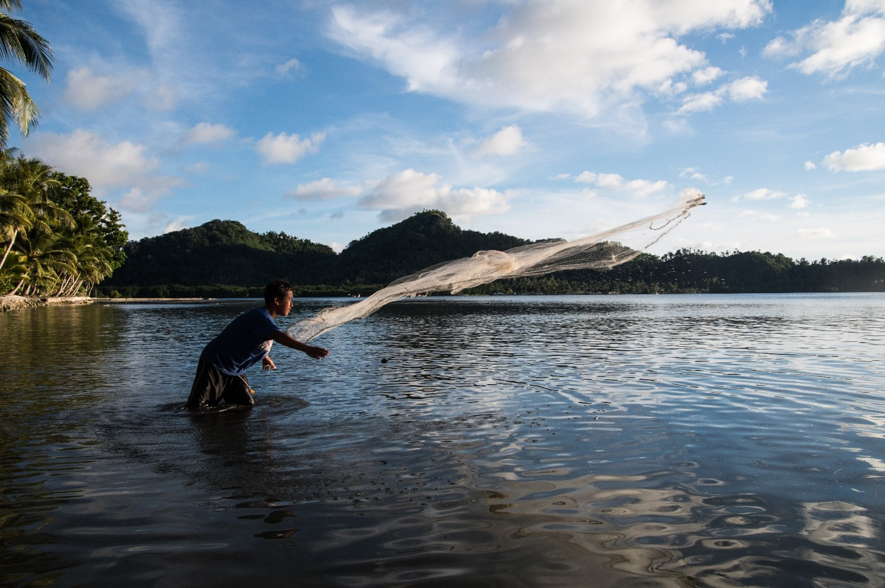
Design of Marine Managed Areas
Locally Managed Marine Areas (LMMAs)
An area of nearshore waters and its associated resources largely or wholly managed at a local level by coastal communities and partners
Notes:
7
Photo credit: Simon Lorentz, Chuuk, Federated State of Micronesia
Key Messages –
-In many places in the Pacific, there is a long history of local communities managing their marine resources in Locally Managed Marine Areas (MMAs). They include no go, no take or limited take areas, usually established for resource management (e.g., to allow populations of fish or invertebrates to recover) or for cultural reasons (e.g., spirit areas or favoured fishing areas of a departed elder).
-Locally managed areas may also cultural or traditional management such as sasi (West Papua), tambu or tabu (no take areas) in some Pacific islands.
-For more information see the LMMA network site (lmmanetwork.org).
____________________________________________________________________________
Scientific Rationale and References:

Slide 8
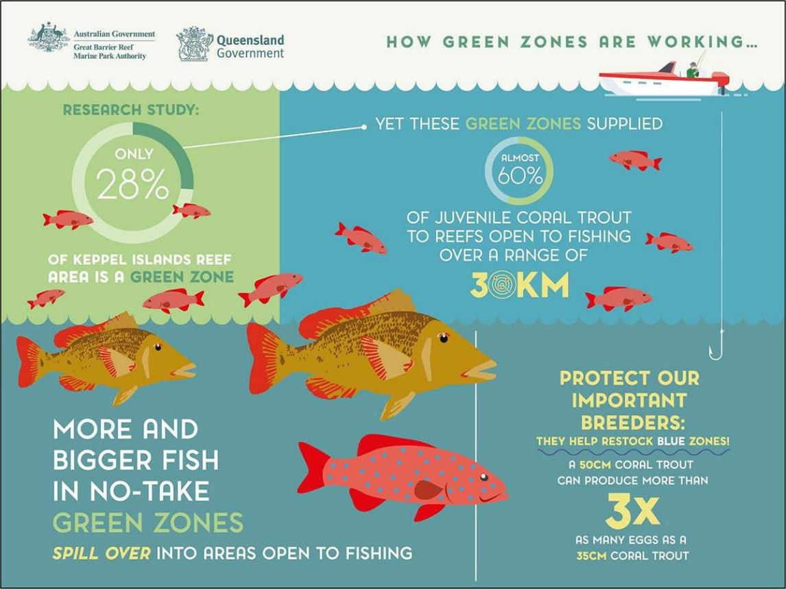
Design of Marine Managed Areas
Fully-Protected Fishery Replenishment Zones (FRZs) are one of the most effective ways to build up fish populations
Notes:
8
Image credit: Great Barrier Reef Marine Park Authority; Queensland Government
Key Messages –
-Fisheries Replenishment Zones (FRZs) are areas of ocean that are protected from extractive and destructive activities and areas with restrictions regarding access and activities (e.g., for fisheries or tourism). FRZs are the most powerful type of managed area and are one of the most effective ways to build up populations of marine species that contribute to spill over and support sustainable fishing.
-When properly designed and managed, zones and rules inside MMAs – especially in longterm or permanent FRZs - provide important species with the healthy habitats and protection that they need to eat, live, grow, and reproduce. Successful reproduction provides an abundance of marine resources. This abundance of resources in one area encourages both adults and larvae to “SPILL OVER” from protected zones to areas where community members can fish and continue to gain sustainable benefits from the zones within the MMA.
-This poster summarizes evidence from the GBR on the role of no-take “green zones” in protecting and producing more and bigger fish and promoting spillover to support fishing in areas outside the green zone, even up to 30km away (Harrison et al. 2012).
____________________________________________________________________________
Scientific Rationale and References:
From Gombos et al. 2013a: FRZs are one of the most effective ways to build long-term abundant fisheries populations and resilience (IUNC-WCPA 2008). The benefits of FRZs are as follows:
• They protect all habitats and species within them, allowing them to eat, grow, and reproduce without the threat of being harvested.
• They can be “fish banks”; they protect the species within them to allow them to become large adults, producing many eggs and larvae.
Fish from these protected areas can provide larvae to replenish the local and surrounding populations.
• They can help to populate areas outside the FRZ. If populations within the area become large and crowded, some adult fish may move
out of the area. This effect is called “spillover.” Scientists have studied this effect. While fish don’t tend to move very far (usually
hundreds of meters to less than one km), fishermen have learned to “fish the boundaries” to benefit from the spillover effect.
• They can help to build the resilience of the area against the impacts of climate change and other threats by providing a safe area where
baby fish are readily produced. These areas can help restore other FRZ and fished areas that have been damaged.
• They can help keep the natural balance of different species, such as predators and herbivores (species that eat algae/plants). Maintaining
a natural balance of species increases their ability to resist impacts from threats, including climate change.
• FRZs can be easier to enforce than other fisheries regulations (for example, size limits or catch limits) because they limit access/use of
a specific area. They are therefore more obvious to comply with and/or observe.
c. For example, a study of Apo Island in the Philippines showed that the biomass of the surgeonfish tripled over 18 years (1983 to 2001) within
the FRZ. Additionally, the biomass of this species increased by a factor of 40 outside of the FRZ (within 250 m of the boundary but not
greater distances away). Finally, in 2000 and 2001, fishermen who used hook-and-line within 200 m of the FRZ boundary, which covers only
11 percent of the total reef fishing area, caught 62.5 percent of the total catch of the entire area for this species (Russ et al. 2003).
GBR POSTER – supporting studies:
Williamson D.H., G.R. Russ, and A.M. Ayling. 2004. No-take marine reserves increase abundance and biomass of reef fish on inshore fringing reefs of the Great Barrier Reef. Environmental Conservation 31 (2): 149–159 DOI:10.1017/S0376892904001262. Density and biomass of coral trout,
Plectropomus spp., an important hook and line fishery species, were measured before and after the implementation of no take ‘green zones’ on the GBR and increased by factors of 4-6.3 (depending on site) in reserve sites. The density of non-target fish species did not differ significantly between fished and reserve sites.
Harrison, H.B., M Bode, D. H. Williamson, M.L. Berumen., and G.P. Jones. 2020. A connectivity portfolio effect stabilizes marine reserve performance. PNAS. https://www.pnas.org/cgi/doi/10.1073/pnas.1920580117. Asynchronous larval dispersal (coral trout) from multiple reserves led to temporal stability in recruitment (‘buffering’) due to a connectivity portfolio effect. The reserves contributed larval spillover to neighboring habitats, but also mitigated temporal fluctuations in dispersal….having a stabilizing effect on fish populations.
Harrison, H.B., D.H. Williamson, R.D. Evans, G.R. Almany, S.R. Thorrold, G.R. Russ, K.A. Feldheim, L. van Herwerden, S. Planes, M. Srinivasan, M.L. Berumen, and G.P. Jones. 2012. Larval Export from Marine Reserves and the Recruitment Benefit for Fish and Fisheries. Current Biology 22:1023-1028. http://dx.doi.org/10.1016/j.cub.2012.04.008. Using genetic parentage analysis, they showed that populations of two important fishery species in reserves contributed 83% (coral trout, Plectropomus maculatus) and 55% (stripey snapper, Lutjanus carponotatus) of their offspring to fished areas.They estimated that the reserves, which accounted for just 28% of the reef area, produced approximately half of all juvenile recruitment to both reserve and fished reefs within 30 km.

Slide 9
Design of Marine Managed Areas
Different Levels of Protection result in different outcomes
Past
Present
Possible futures depending on protection
Fully protected
Highly protected
Lightly protected
Minimally protected
From Grorud-Colvert et al. 2021.
Notes:
9
Image credit: Grorud-Colvert et al. 2021.
Key Messages –
-Not all MMAs are the same. They range from fully protected to minimally protected and those different levels of protection likely lead to very different outcomes in terms of supporting rebuilding of marine populations and protection of habitats.
-Fully protected areas provide the most ecological benefits by prohibiting extractive activities and minimizing impacts.
-MMAs that protect most of the species in their boundaries, but perhaps allow for some sustainable extractive uses, can be considered highly protected and also contribute significantly to protecting and rebuilding marine populations. An example might be allowing catch of mobile pelagic species, while protecting reef-associated species.
-MMAs that allow significant extractive or destructive activities only offer limited or minimal protection from and rebuilding of most marine populations should not be an expected outcome.
-It is very important to consider the allowed activities within a MMA and to make sure that the true level of protection provided by a MMA will be sufficient to meet management objectives.
____________________________________________________________________________
Scientific Rationale and References:
Grorud-Colvert et al.,2021. The MPA Guide: A framework to achieve global goals for the ocean. Science 373, 1215.
“The level of protection, and therefore the effectiveness of MPAs, will greatly influence the future state of the ocean. Past ocean ecosystems were abundant and
diverse in species and habitats. Over time, expanded and intensified human activities depleted and disrupted ocean ecosystems and reduced their services. MPAs, in conjunction with climate mitigation strategies and more sustainable uses of the ocean, can conserve and restore biodiversity and the resilient ecosystems needed for human well-being. Different levels of protection will result in different outcomes, if enabling conditions are satisfied”.
“The four LEVELS of protection from abatable activities within an MPA (or MPA
zone), based on allowed activities, are (i) Fully Protected—no impact from extractive or destructive activities; (ii) Highly Protected—minimal impact; (iii) Lightly Protected—moderate impact; and (iv) Minimally Protected—high total impact, although still an MPA by IUCN criteria.
Extensive literature globally shows that a high level of protection, and in particular no-take areas, is most effective at protecting biodiversity and rebuilding fish stocks – this is especially true for no-take, fully protected areas that adequately prohibit extractive and destructive uses (Claudet et al. 2008; Lester et al. 2009; Molloy et al. 2009; Giakoumi et al. 2017)
Claudet J. et al.. 2008. Marine reserves: Size and age do matter. Ecol. Lett. 11, 481–489. doi: 10.1111/j.1461-0248.2008.01166.x; pmid: 18294212
Giakoumi, S. et al., Ecological effects of full and partial protection in the crowded Mediterranean Sea: A regional
meta-analysis. Sci. Rep. 7, 8940 (2017). doi: 10.1038/ s41598-017-08850-w; pmid: 28827603
Grorud-Colvert et al., 2021. The MPA Guide: A framework to achieve global goals for the ocean. Science 373, 1215.
Lester, S.E. et al. 2009. Biological effects within no-take marine reserves: A global synthesis. Mar. Ecol. Prog. Ser. 384, 33–46
doi: 10.3354/meps08029
Molloy, P.P, I. B. McLean, I. M. Côté. 2009. Effects of marine reserve age on fish populations: A global meta-analysis.
J. Appl. Ecol. 46, 743–751 (2009). doi: 10.1111/j.1365-2664.2009.01662.x

Slide 10
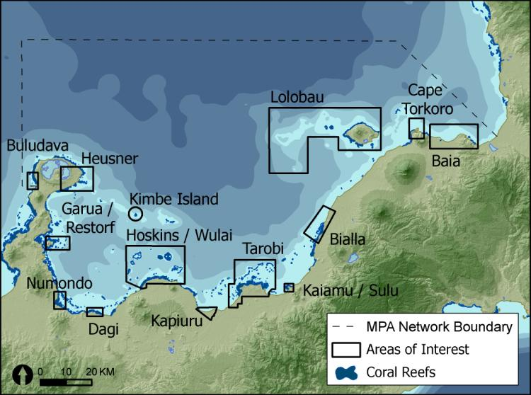
Design of Marine Managed Areas
What Are MMA Networks?
Example of a design of a network of MMAs in Kimbe Bay, Papua New Guinea
MMA Networks - are a collection of individual managed areas that are ecologically connected (such as through larval dispersal) to promote benefits that are greater than can be achieved by single managed areas.
Notes:
10
Image credit: Green et al 2009.
Key Messages:
- Individual MMAs are important for maintaining the health of local natural resources and the community. However, it’s also important to know that marine resources are connected to other areas through wind, currents, and the movement patterns of species. The health of one system often depends on the health of nearby and connected systems. Therefore, if you only manage one small area, it can be difficult to protect the system’s overall health in the long term and only some kinds of management objectives can be achieved at the local scale.
-MMA Networks are a collection of individual areas that are ecologically connected. For the same amount of spatial coverage, networks of MPAs can potentially deliver most of the benefits of well managed individual MPAs, but with less costs due to greater flexibility and diversity in size, shape, distribution and location. They can also deliver additional benefits by increasing the chance of protecting multiple examples of features of interest, spreading the risk from threats across a larger spatial scale, and enhancing the probability of overall persistence of habitats, populations and species (by acting as mutually replenishing networks to facilitate recovery after disturbances.
-Therefore some management objectives may require working with nearby communities to manage larger connected areas through the establishment of MMA networks across a broader seascape. As an example, a resilient network of MPAs was designed for Kimbe Bay in Papua New Guinea and, where possible, the design included at least three widely separated examples of each major habitat type.
_______________________________________________________________________________________
Scientific Rationale and References:
MPA Networks can deliver additional benefits by acting as mutually replenishing networks to facilitate recovery after disturbances (see review in Green et al. 2020), allow crucial spatial links needed to support ecosystem connectivity, and reduce socioeconomic impacts.
Green et al (2009). For this example, a resilient network of MPAs was designed for Kimbe Bay in Papua New Guinea. Where possible, the design includes at least three widely separated examples of each major habitat type in Areas of Interest (to be considered as potential areas for establishing new MPAs). Locally managed marine areas (MMAs) have now been established in many of these AOIs by local communities (Weeks et al. 2014).
Gombos et al. (2013a). – provided definition of MMAs networks used above.
From Green et al. 2014: “Marine reserve networks are collections of individual reserves that are ecologically connected (Dudley 2008; IUCN-WCPA 2008). Such networks can deliver additional benefits through mutual replenishment of individual reserves (e.g., Harrison et al. 2012), which facilitates recovery after disturbance (McLeod et al. 2009). The design and effective management of ecological networks of marine reserves is critical to maximize their benefits to fisheries management, biodiversity conservation, and climate change adaptation (Walmsley and White 2003; McLeod et al. 2009; Gaines et al.
2010). Existing ecological guidelines for designing marine reserve networks have focused on achieving either fisheries (e.g., Fogarty and Botsford 2007), biodiversity (e.g., Almany et al. 2009) or climate change (e.g., McLeod et al. 2012) objectives independently, or fisheries and biodiversity (Roberts et al. 2003; Gaines et al. 2010) or biodiversity and climate change (McLeod et al. 2009) objectives combined. While there are many similarities among guidelines for achieving different objectives, there are some key differences, particularly regarding marine reserve size and duration of protection (i.e., permanent, long or short term, or periodic closures). Consequently, marine reserves designed to maximize fisheries benefits are seldom designed to maximize their contribution to protecting the full range of biodiversity in the face of climate change (e.g., Hamilton, Potuku, and Montambault 2011).“

Slide 11
Design of Marine Managed Areas
Spatial Design Guidelines to Meet Management Objectives
Biophysical Design Guidelines for Marine Managed Areas
to Enhance and Maintain
Coral Reef Fisheries
in the Pacific Islands
Socioeconomic and Cultural Design Guidelines
for Marine Managed Areas
to Enhance and Maintain Coral Reef Fisheries
in the Pacific Islands
Biophysical Design Guidelines for Marine Managed Areas to Enhance and Maintain Coral Reef Fisheries
In Hawaii (TBD)
Notes:
11
Key Messages:
When spatial management is a preferred or complementary option to other management actions, then it is important to ensure that the managed areas are designed to meet the community’s objectives.
Biophysical design guidelines will contribute to a larger process that includes implementing MMAs in ways that complement human uses and values, and align with local legal, political and institutional requirements. To make sure this is the case, they will be used in conjunction with socioeconomic and cultural design guidelines.
Where: (define each)
Biophysical design criteria are aimed at achieving ecological objectives by taking key biological and physical processes into account.
Socioeconomic and cultural design criteria are aimed at maximizing benefits and minimizing costs to local communities and sustainable Industries and respecting local culture.
Most of these design criteria relate specifically to Fisheries Replenishment Zones (FRZs) because they provide the greatest ecological benefits for enhancing fisheries productivity, protecting biodiversity and adapting to climate change (Edgar et al. 201 4). These criteria can also be applied to other types of zones, although they are likely to be less effective in achieving these objectives (Knowles et al. 2017).
Managers and key stakeholders should adapt and refine these design guidelines to address the goals and objectives of their MMA or MMA Network and to consider their local biophysical, socioeconomic and cultural context.
_______________________________________________________________
NOTE: This presentation provides key considerations and design guidelines for designing spatial management areas, with key messages and scientific rationale provided in the speaking notes. Sometimes we provide additional slides to demonstrate an important point.
NOTE: These guidelines should be adapted and refined when designing MMAs in different locations, based on local and scientific knowledge of the biophysical characteristics of the area. To assist with this process, we provide an example of how to apply these design guidelines in Hawai’i. In this presentation:
Blue slides provide general guidance biophysical design guidelines for the Pacific Islands; and
Green slides provide an example of how this general guidance has been refined for one location (Hawai’i).
Orange slides provide general SEC for the Pacific
___________________________________________________________________________________________
Scientific rationale and references:
-Design criteria provide specific advice on how to design MMAs/FRZs and MMA Networks to achieve the community’s goals and objectives (Green et al. 2013).
Facilators are often needed to guide communities in designing effective MMAs and MMA networks. Design guidelines help communities understand how to design MMAs and where to place them to acheive their goals. (Green et al. 2020).
MMAs and MMA Networks play an important role in conservation and management of marine resources. However, they can only achieve their objectives if they are well designed and effectively managed (Green et al. 2014, Gill et al. 2017, Giakoumi et al. 2018).
MPA goals and objectives should be clearly defined first to inform the design and to facilitate broader acceptance of MPAs by a range of stakeholders (Giakoumi et al. 2018).

Slide 12
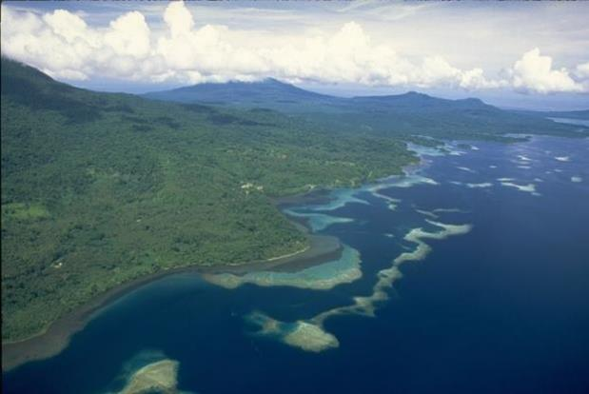
DESIGN OF MARINE MANAGED AREAS
These biophysical and socioeconomic-cultural guidelines will help communities make informed choices and understand tradeoffs in the design of MMAs.
Notes:
12
Image credit – Garry Bell. Kimbe Bay, PNG
Key Messages:
While there are a lot of biophysical and socioeconomic guidelines, it’s important to incorporate as many as you can. It’s often not possible to incorporate them all, and there are also tradeoffs between guidelines. For example with the size and location of MMAs, where larger MMAs may better help meet fish population rebuilding goals, but may come at the cost of socioeconomic goals. Or the opposite where small MMAs may have lower costs, but not necessarily meet ecological goals. ….
__________________________________________________________________________________________________
Scientific Rationale -
In summary, MMAs should be designed and managed to:
maintain or enhance populations of fishery species and biodiversity;
support community food security, livelihoods, and cultural practices;
have appropriate level of protection and permanence to meet management objectives;
incorporate stakeholder input and engagement to build social acceptance;
use the best available information, including academic and traditional and local knowledge; be appropriate for the local management and cultural context; and
be adaptive and resilient in the face of climate and ocean change.

